Slide 1

ACME FINANCIAL SERVICES
SOFTWARE SOLUTION REPORT

Slide 2
Organisational Report
AT 1.1

Slide 3
Organisational Structure
Admin
Accounts
Sales
International
Notes:
Admin:
For staff
Perform day to day organizational tasks
Assist other staff with office related problems
Accounts:
Oversees account information
Payroll and staff expenditures
Accounts and purchasing
Sales:
Also four staff
Maintains local client relationships
Builds local client portfolio
Manages sales to local clients
International:
Two staff
Handles international clients
Builds international portfolio
Manages Sales to international clients

Slide 4
Organisation Diagram
Steve Hall
CEO
Deb Papadopoulos
Admin
Dawn Schultz
Accounts
Danny Jones
Sales
Paul Trang
International
Mary Johnson
Payroll
Ted Sloan
Procurement
Casual
General
Casual
General
Paula Manning
Office Assistant
Joe Franco
Senior Admin
Helen Harris
Senior Admin
Joan Williams
Office Assistant
Terry Shugart
Kalgoorlie Sales
Alan Fave
Pilbara Sales
Michael Albro
Pilbara Sales
Santo Anderson
Kalgoorlie Sales
Terry De Santo
International Sales
Mae Willis
International Sales
Notes:
Organisational chain of command structure of the company
Top down

Slide 5
Technical Document Report
AT 1.2

Slide 6

Problem Statement:
The current file and accounts management system is inefficient and alienates existing and prospective clientele
Notes:
File management system causes unnecessary workloads for staff
Affecting business revenue
Causing decline in profits
Reducing market share and client portfolio

Slide 7
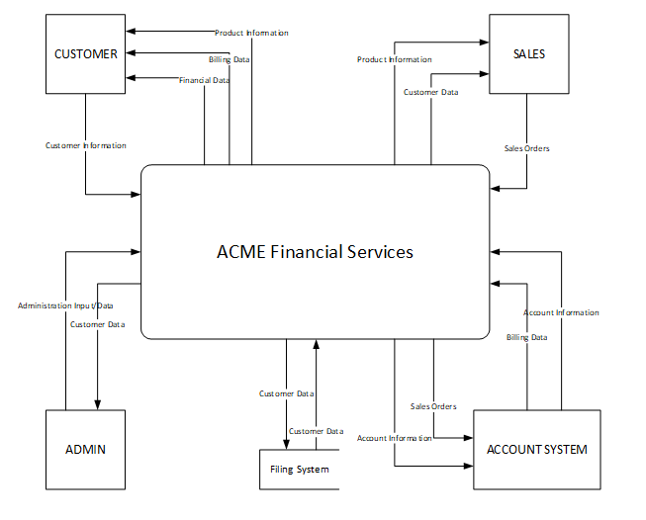
Context Diagram

Slide 8
Technical Document Reference
ISO/IEC 26514
Available for purchase through:
https://infostore.saiglobal.com/en-au/Standards/ISO-IEC-26514-2008-589528_SAIG_ISO_ISO_1350435/
Notes:
ISO/IEC 26514 is a technical documentation standard
Developed by the International Electrotechnical Commission, in collaboration with International Organisation for Standardisation
Provides specifications and guidelines for designing user and development documents

Slide 9
User Requirements
AT 1.3

Slide 10
Use Case Scenarios
Use Case | Actor | Description
Log On | Client | Client logs securely onto the system
Edit Client Information | Client | The client can edit any personal information for the purposes of updating records
Display Transactions | Client, Staff, Managers | The Actor can view financial history, Managers and staff are able to view financial reports and further information regarding the client’s financial history
Print Transactions | Client | The client can print historical transactions in PDF format
Recover Login Information | Client | The client can access lost login information via secure methods.
Join E-mail | Client | Allows the client to opt into email notifications of new products
Suspend Client | Staff | Allows staff to suspend clients and lock their respective accounts
Access Database | Staff | Sales team members in the field will be able to remotely access client database
Manage Privileges | Managers | Managerial staff will be able to change the privilege levels of staff.
Create Client Profile | Sales Staff | Sales staff will be able to create new Client user profiles depending on sales outcomes
Notes:
Table shows the use case scenarios required by the system

Slide 11
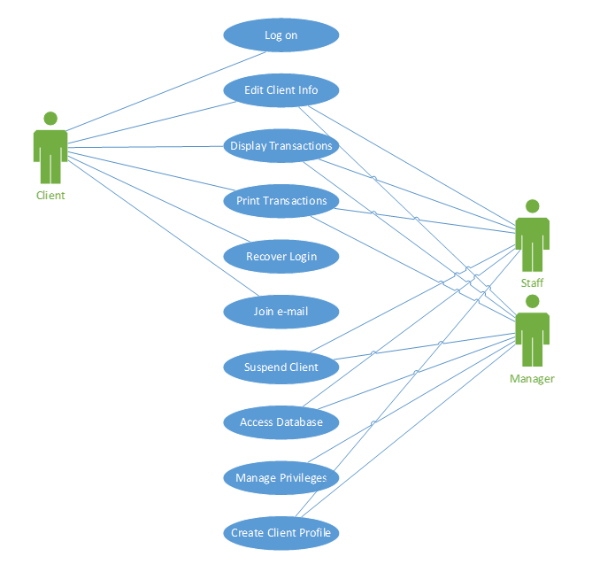
Use Case Diagram

Slide 12
Functional Requirements
Clients must log on to access data
Business Rules
Transaction corrections, adjustments and cancellations
Administrative Functions
Authentication
Authorisation levels
Audit Tracking
External Interfaces
Certification Requirements
Reporting Requirements
Historical Data
Legal or Regulatory Requirements
Notes:
Functional requirements of the system
The system must PERFORM all of these requirements

Slide 13
Non-Functional Requirements
Web portal will be the first point of entry for the public/clients
Clients will be able to log into their accounts via the web portal
Clients will be able to edit personal information
Clients will only be able to view their own information
Historical transactions can be accessed by clients, staff and managers
Historical transactions cannot be edited, but can be printed in PDF format
Web portal will display live information about stock and currency markets
Web portal will display various services provided by sales team
Web portal will offer a help desk option to recover lost login information
Database will be accessible remotely via mobile devices
Database will offer rapid response times and current data
Database will have hierarchical security for all users
Managers will have administrator rights to partition privileges to users
Web interface will be accessible for smart phones (android and IOS), 7” and 10” tablets, and pc’s
Database interface will provide options to lock and suspend client accounts, and display financial history reports
Database interface will provide options to update transaction and client details.
Notes:
Non-Functional requirements for the system
The system must HAVE these requirements

Slide 14
Recommendations
Database redundancies for system failure
Personalised contact information provided to clients for specific sales representatives
Notes:
Database Redundancies:
Redundancies will need to be put in place to ensure the safety and reliability of the system and the data it contains
Personalised Contact information:
Web-Portal will display the contact information of the sales representative managing the respective clients portfolio

Slide 15
Feasibility Report
AT 1.4

Slide 16

Product
Database solution that provides a seamless end user experience
Notes:
Cohesive file management solution with front and backend functionality.
Broad spectrum of device compatibility
Offsite access to database services

Slide 17
Technical Feasibility
Performance
Operational Characteristics
Scalability
Notes:
Three main points to consider
Performance: Targets will need to be measured and achieved
Bandwidth operations
Speed and reliability optimisation
Operational uptime
Considering the small scope of the project, the technology requirements are available to meet these needs.
Operational Characteristics:
Will require a dedicated data storage solution
Will need to interface with the web portal and user interface
Accessible for remote staff
Cloud based solutions are a logical choice to meet these needs and cloud server products have become relatively cheap in recent years
Scalability:
Software will need to operate on multiple devices
Mobile devices will require software implementation
Portability of design languages is key
There are a number of cross-platform languages that would be suitable for use when designing software like this. Java, Python, etc.

Slide 18
Operational Feasibility
Organisational Requirements
Operational Effects
Employee Response
Notes:
Three key areas that will need to be addressed when considering the Operational Feasibility of the project
Organisational Requirements:
Current file management system is archaic. Digitising the files will allow ease of use for customers and staff alike, and reduces resource costs to maintain the system
Operational Effects:
Business operations will change and staff will need to be trained in the system
Training will need to be implemented at various levels throughout the business depending on the level of access and type of use staff require
Employee Response:
Questionnaire indicates that the proposed software solution has been well received by staff, however there are areas of concern regarding levels of discomfort and insecurity about the system
Information sessions targeted towards the areas of the business that have these concerns, as well as evaluating feedback from employees upon implimentation

Slide 19
Economic Feasibility
Costs
Benefits
Notes:
Costs include:
Design and Labour - $22,650
Cloud Database Solution, User Interface, Web Portal and relevant Software - $4,329
Hardware upgrades, data redundancy technology and equipment - $4,389
Expected Operational costs - $2,350
Unexpected Operational budget (Conditional Return) - $3,000
Training costs - $3,275
Total cost– $39,993. Falls within the budget provided
Benefits include:
Improved record keeping efficiency - $216,000 per year (based on expected 80% reduction in operational resources spent on record keeping)
Client Acquisition and Retention - $550,000 per year (projected yearly sales growth post implementation)
Total financial return of $766,000 p.a.
Qualitative benefits:
Ease of use for clients and staff
Maintaining competitive market presence
Increase of reputation as company evolves to meet a changing financial climate

Slide 20
Alternative Solutions
Microsoft Azure
Microsoft SharePoint
Notes:
Microsoft Azure:
Cloud database solution
Interfaces with SharePoint
Reduces the production of training material needed as there is already a wealth of user documentation
Increased monthly operating cost of over $9000 per month
Increased costs for unnecessary functionality
Microsoft SharePoint:
Out of the box user interface and database solution
Will integrate with Microsoft Azure
Total costs to implement fall outside of projected budget and result in diminished functionality and scalability

Slide 21
Software Solutions
AT 1.5

Slide 22
Software Development Life Cycle
Planning and Requirement Analysis
Defining Requirements
Designing the Product Architecture
Build and Development
Testing
Deployment and Maintenance
Notes:
Planning and Requirement Analysis:
Requirement data is taken from respective sources
Data is then analysed
Plan is created from the analysed data
Defining Requirements:
Requirements are defined by laying out performance and functionality expectations
Requires customer approval before proceeding
Compiled into an SRS - Software Requirement Specification document
Designing the product Architecture:
Provides a modular architectural blueprint for the development phase of the software
Will include communication and data flow representations and charts
Documented within a DDS – Design Document Specification
Build and Development:
Marks the actual construction of the product
DDS is used during this stage to develop the code that follows the correct infrastructure and processes
Code guidelines should be followed during this stage
Testing:
Used to identify and problems within the product
Errors are identified and reported
Development team implements fixes
Deployment and Maintenance:
Released for use upon completion of development and testing
Post release problems are addressed unless they are outside scope, which could incur additional costs

Slide 23
SDLC Options
Waterfall Model
Agile Model

Slide 24
Waterfall Model
Pros
Cons
Ease of use
Clearly defined stages
Clearly defined goals
Organisationally simple
Processes and results are well documented throughout stages
Structure of the model ensures simple management of deliverables
Testable or usable software is not available until late during the life cycle
High risk and uncertainty factor due the rigid nature of the model
Simplicity of the model does not mesh well with complex object orientated projects
Structure of the model makes changing requirements difficult to implement
Measuring progress of the product development is difficult
Integration is done at the end of the project and doesn’t allow identification of technology or business bottleneck or other issues earlier within the development life cycle.
Notes:
Waterfall model follows a step by step process that has clearly defined stages within the development cycle.
Typically these are Planning>Development>Testing>Deployment

Slide 25
Agile Model
Pros
Cons
Promotes teamwork and cross training
Rapid development of functionality and features
Low resource requirements
Adaptable to changing or added requirements
Delivers basic working products incrementally
Documentation is easily employed
Little to no planning required before development begins
Allows the developers to be flexible with the project
Minimises scope creep
Development progress is easily measured
Difficult to handle complex dependencies
Risk of sustainability and maintainability of the project
A high-level plan and appropriate team leader is required to implement agile methods
Deadlines for deliverables require strict adherence
Depends on customer involvement with the project. Deliverables require continuous sign off during the development of the project
Individual responsibility of each team member is high as there is little documentation for them to follow.
Transfer of technology to additional team members can be difficult as little documentation is produced
Requires strict adherence to code practices to ensure that code is uniform and readable across all areas of the project
Notes:
Agile model follows an iterative process that combines all stages of development into short “sprints of activity
Deploys software in iterations
Sprints typically last a few weeks

Slide 26
Recommendation
Agile Model
Notes:
Agile methodologies most appropriate for project of this size and scope
Alleviates risk by easily allowing the implementation of changes
Minimises gold plating
Allows the product to be deployed in increments – minimizes the amount of training time necessary for staff. Allows gradual familiarity to develop with the system

Slide 27
Risk Assessment
AT 1.6

Slide 28
Critical Risks
Development of Incorrect User Interface
Gold Plating
Changes to Requirements
Notes:
Three critical risks identified within risk assessment matrix
Strategies and recommendations for each

Slide 29
Development of Incorrect User Interface
Strategies
Surveying and End User Analytics
Development and Testing
Review and Implementation
Notes:
Surveying and End User Analytics:
Survey end users to define functionality and ease of use required
Analytics on targeted end users, examine mental models
Define end user work scenarios
Define UI goals and requirements
Development and Testing:
Develop a prototype for testing purposes
Test prototype on selected sample user groups
Collect feedback from test users
Review and Implementation:
Review feedback data from analytics and testing
Ensure new goals and requirements are documented
Implement necessary updates or changes
Return to testing phase to test updates or changes when appropriate

Slide 30
Development of Incorrect User Interface
Recommendations
Survey and Test
UI development Planning
Design Collaboration
Supplementary administrative UI
Notes:
Survey and test prototype on high risk staff identified in the risk matrix
Develop and implement a plan based on the previously outlined strategies
Ensure that all members of development team are working collaboratively in relation to UI
Develop secondary high level UI for administrative users with increased functionality

Slide 31
Gold Plating
Strategies
Succinct Development Plan
Task Delegation
Productivity Management Techniques
Allocation of Resources
Notes:
Create a development plan that addresses only the functionality defined within the scope of works.
For larger projects that require multiple teams, delegate tasks appropriately to each team to ensure that resources are used effectively.
Employ project management techniques and processes that ensure that software development staff are kept on task.
Allocate additional resources, or resources that free up onto critical areas of functionality defined within the original scope of work that may be behind schedule.

Slide 32
Gold Plating
Recommendations
Communication of Scope
Implement Appropriate SDLC practices
Notes:
Ensure that the scope of works is clearly communicated to staff and emphasise that work is to be aimed at delivering on the scope, not on extras.
Implement agile software development practises. Short sprints of work ensure that there isn’t excess time spent in development that is then wasted on gold plating. Additionally, the customer then reviews and accepts the results quickly, ensuring that the product is up to the expected standard of the customer, not the standards of any project team members that may have perfectionist qualities.

Slide 33
Changes to Requirements
Strategies
Define and Baseline Requirements
Scope Creep monetization
Development Team Comprehension
Existing Product Identification
Stakeholder Surveys
Pending Change Requests
Customer History
Change Request Impact
Change Implementation Resources
Notes:
Define and baseline the requirements for the project prior to commencement.
Ensure that any additional features or requirements defined by the customer incur additional cost after the scope has been initially defined.
Ensure that the development team have a solid uniform understanding of what the customers requires with the system.
Identify existing products on the market with similar functionality that can be used to baseline or establish firm requirements.
Administer surveys to stakeholders to identity desired user functionality within the system.
Identify any known change requests that are pending.
Identify whether the customer has a history of requesting changes beyond the agreed scope.
Analyse whether the change will impact the performance or the existing desired functionality of the system.
Identify the resources required to implement the change.

Slide 34
Changes to Requirements
Recommendations
Scope Creep Budget
Change Request Communication
Analytics of Existing Similar Products
Notes:
Ensure that changes to the scope are identified within the scope of works, and will require additional cost on behalf of the customer to implement changes beyond the originally agreed upon scope of works
Communicate any requested changes to key stakeholders to ensure that the changes to functionality are necessary.
Research and analyse existing products already on the market when defining the scope and or changes to the scope.
Scope Creep Budget
Change Request Communication
Analytics of Existing Similar Products

Slide 35



Thankyou
kyer-p@atex-solutions.com.au
Phone: 0404 040 404
Web: www.atex-solutions.com.au
Notes:
Questions?

